Slide 1

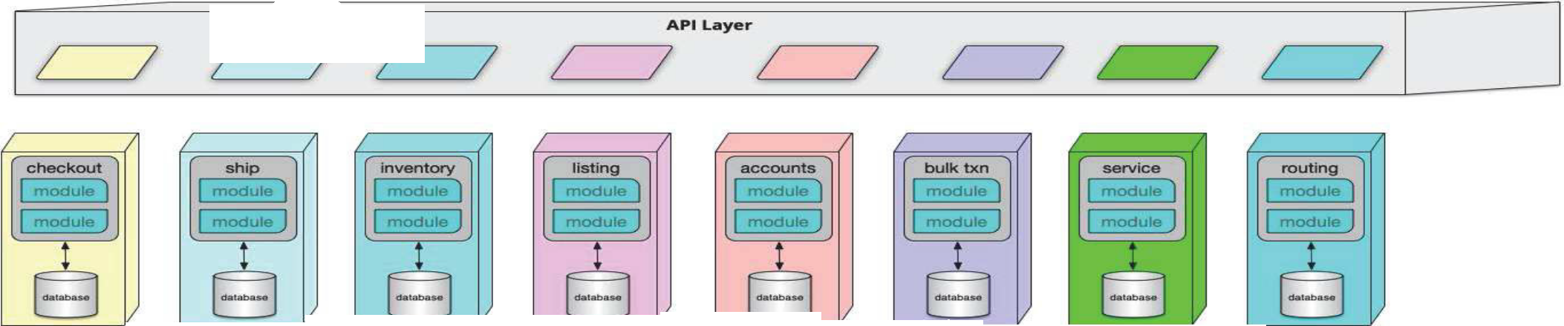
























































































Microservices
diat
mediator
bo
ntexts
nde
o
bounded c
ntexts

Slide 2
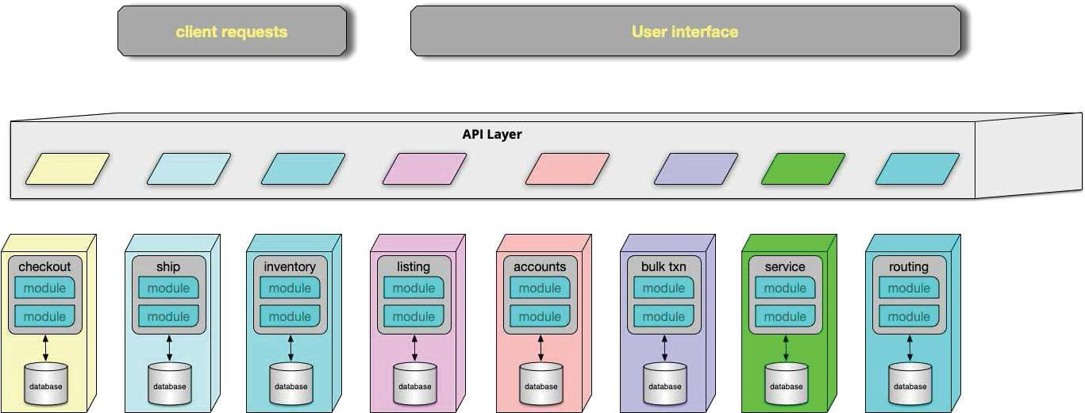
Microservices

Slide 3
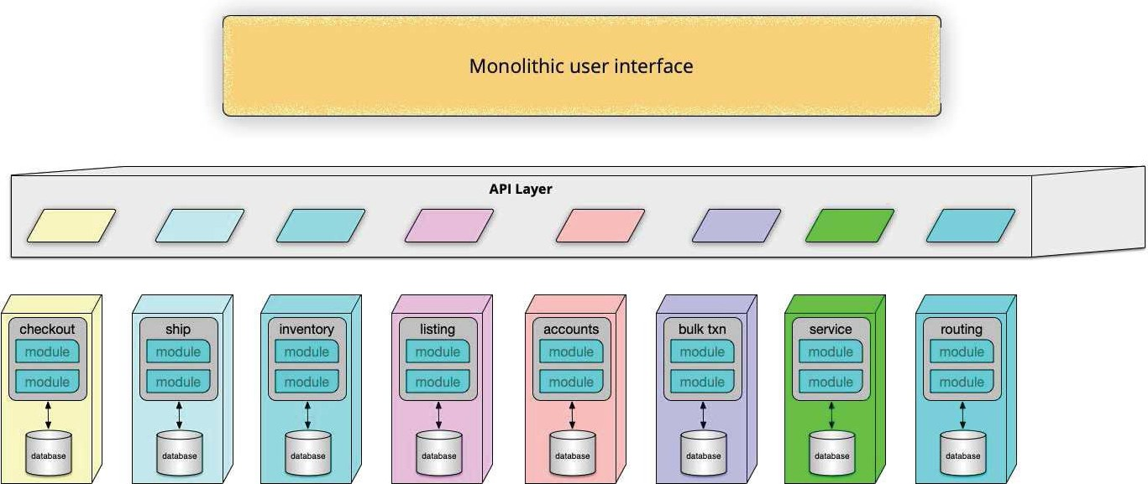
Microservices: Monolithic UI

Slide 4
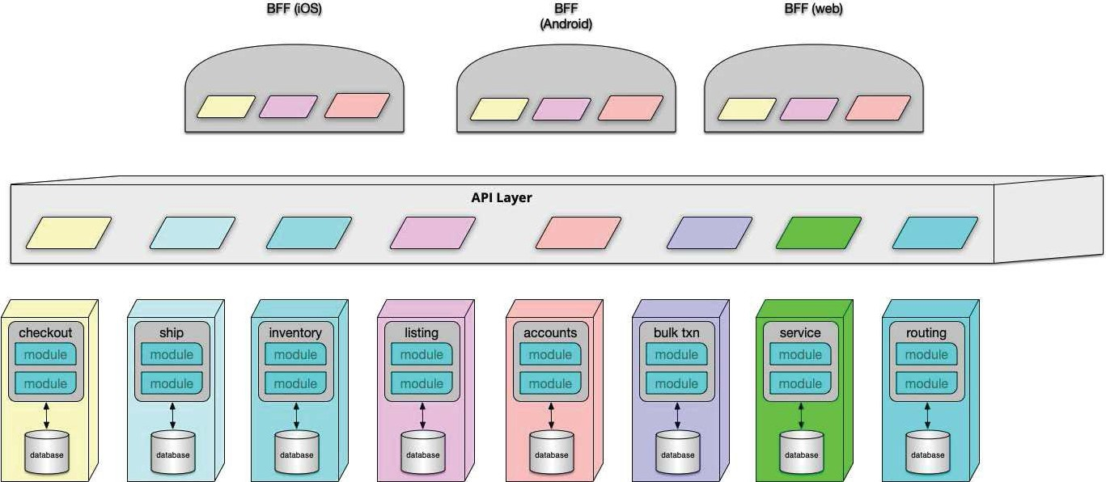
Microservices :BFF

Slide 5
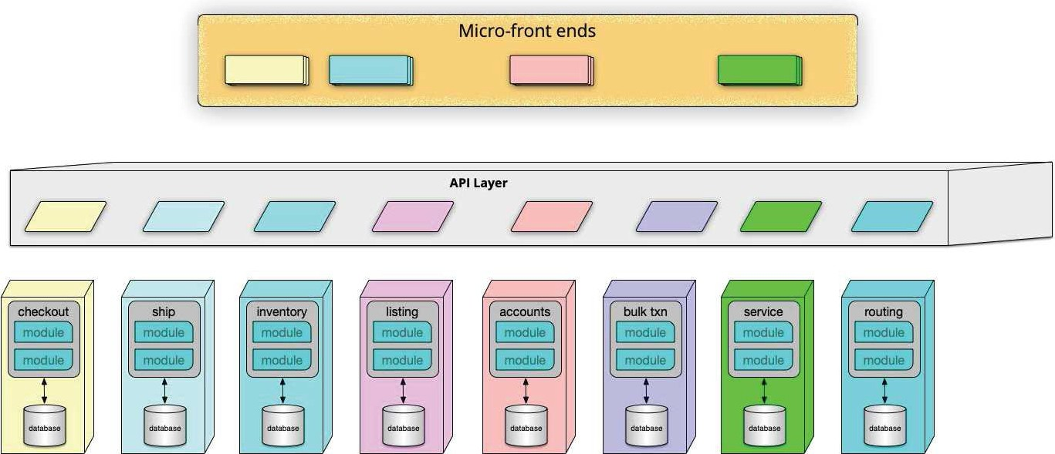
Microservices

Slide 6
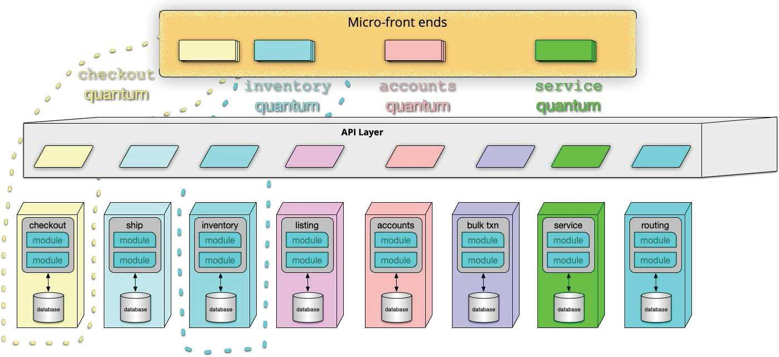
Microservices

Slide 7

support ∆
Microservice is the first architectural style developed post-Continuous Delivery.

Slide 8
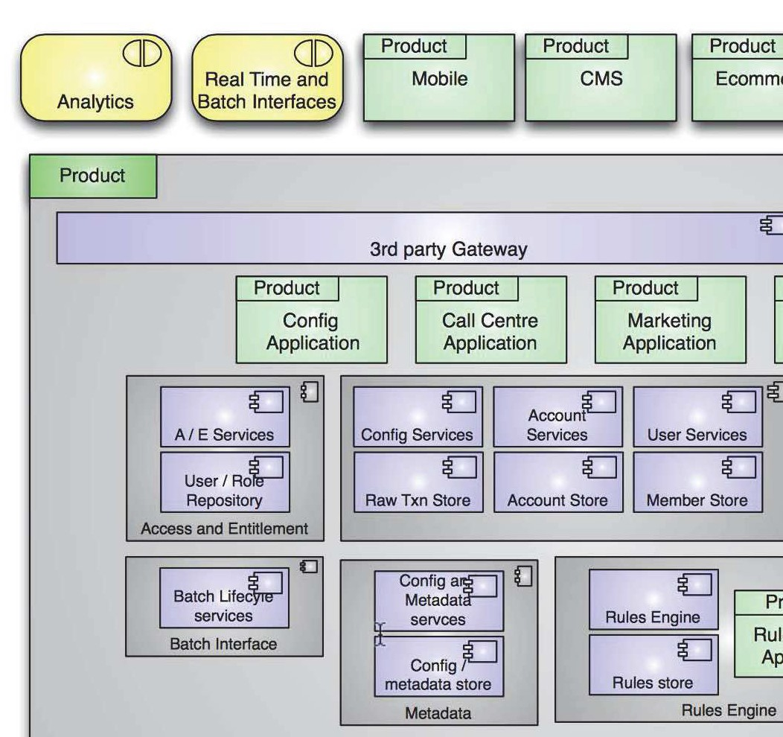
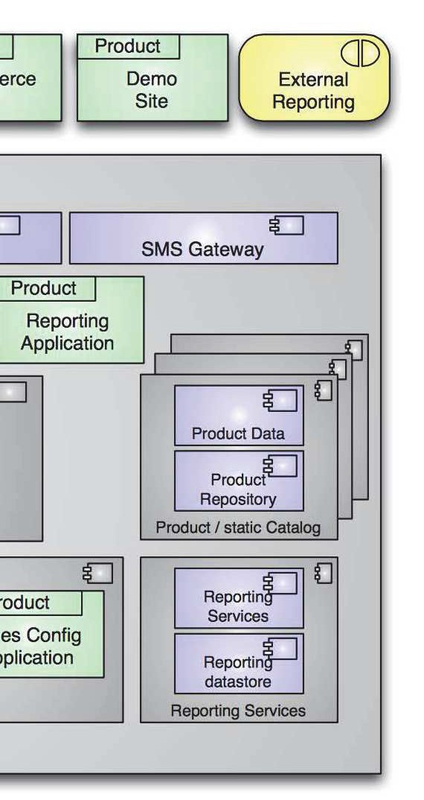
microservice implementation
http://2012.33degree.org/pdf/JamesLewisMicroServices.pdf http://www.infoq.com/presentations/Micro-Services

Slide 9
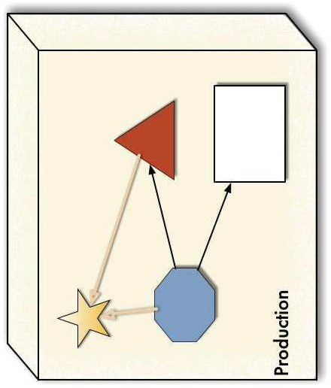

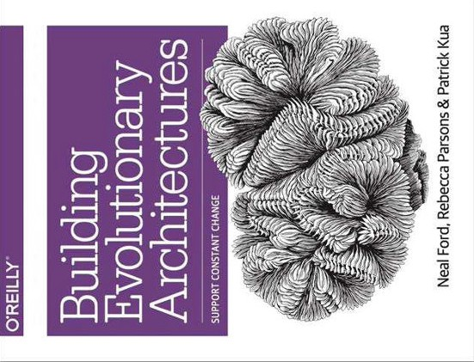

Slide 10
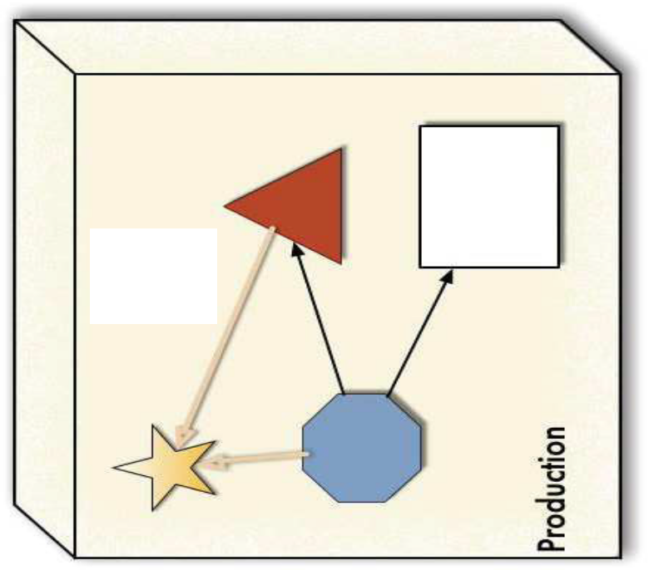


Slide 11
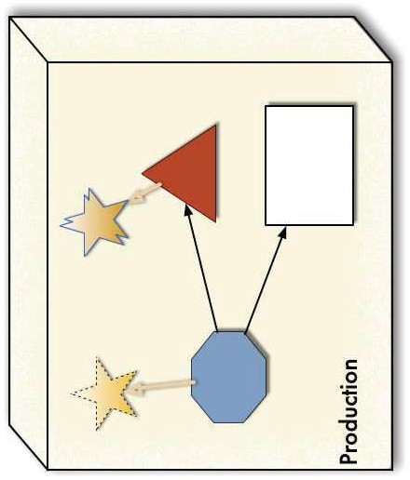

Slide 12
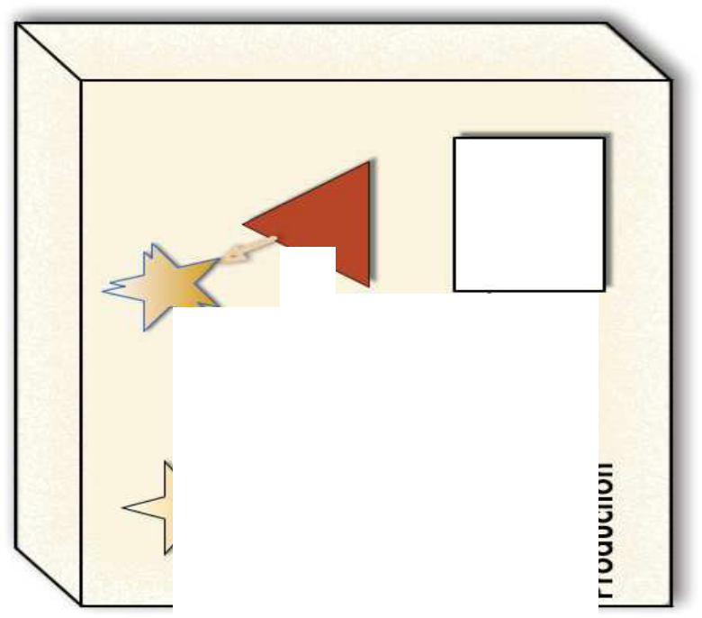


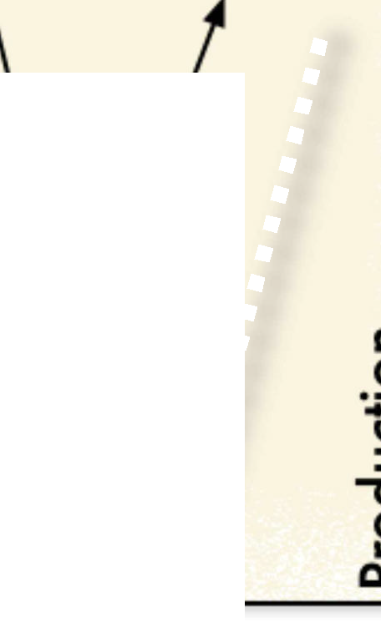



















Slide 13
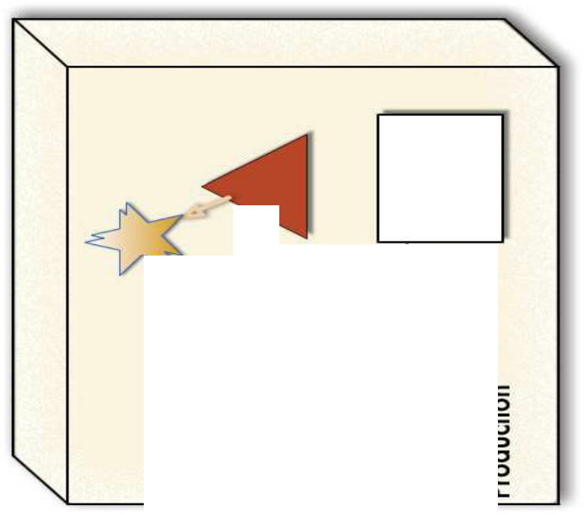







Slide 14












Slide 15
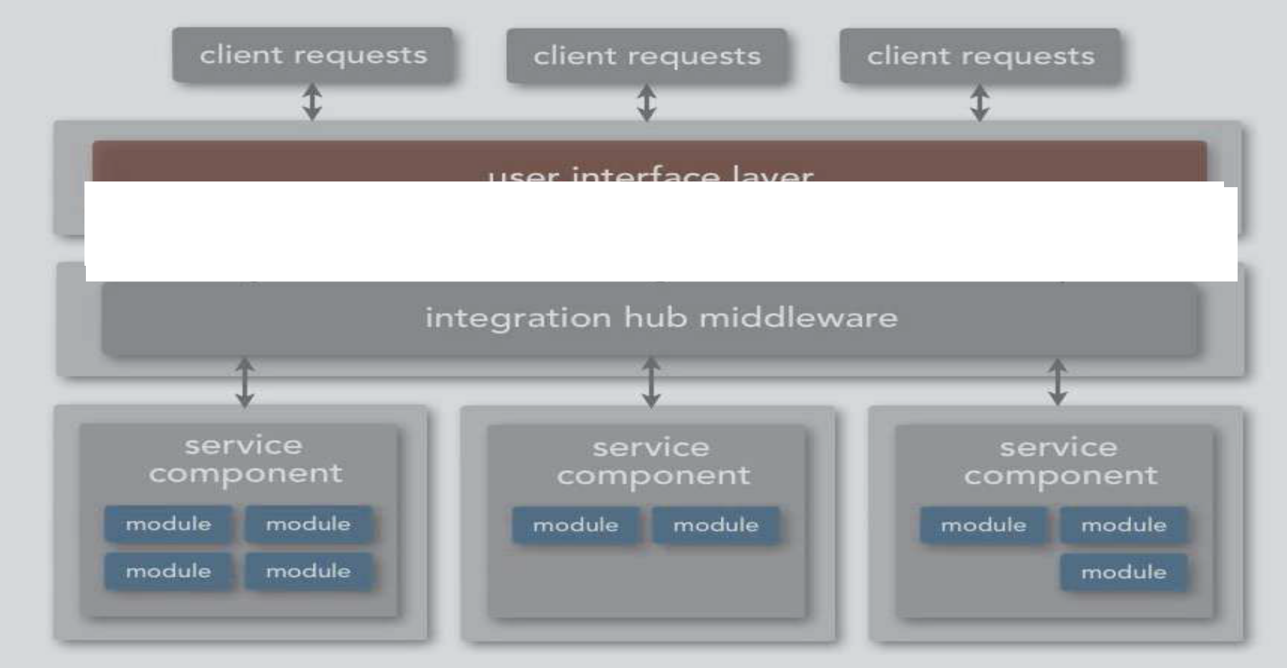


sErVicE-BaSEd aRchiTEcTuRe

Slide 16





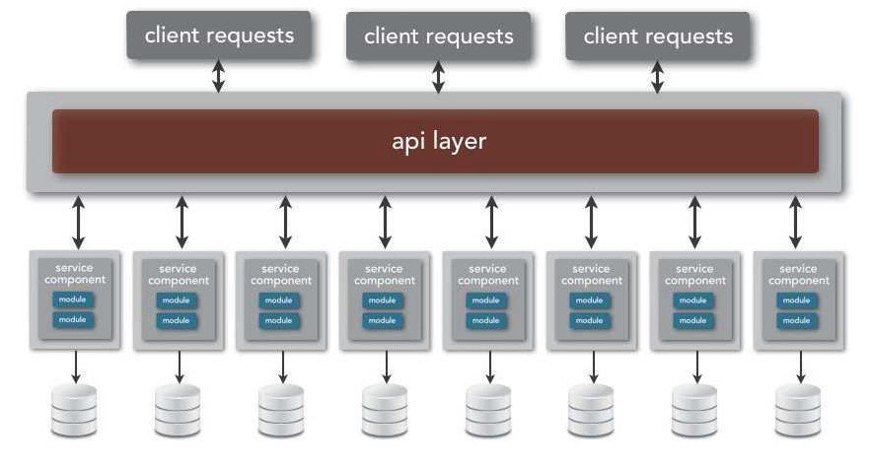


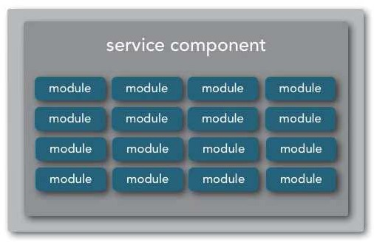

service-based architecture
the goals of microservices!
client requests
client requests
client requests
user interface layer
!with real-world constraints.

Slide 17



service-based architecture

Slide 18
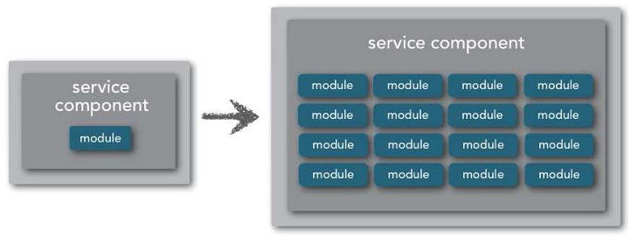
service-based architecture
service granularity

Slide 19
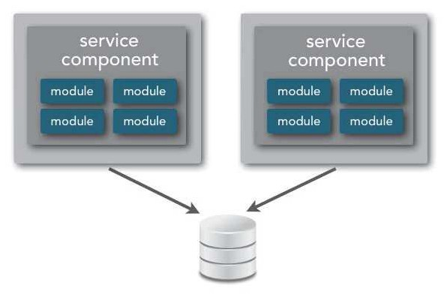
service-based architecture
service granularity
database scope

Slide 20


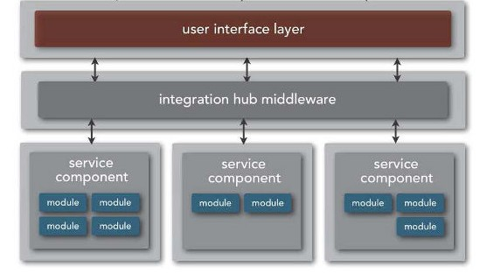
service-based architecture
service granularity
database scope
integration hub

Slide 21







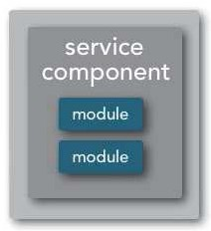
service-based architecture
service granularity
client requests
client requests
client requests
api layer

Slide 22




service-based architecture
service granularity
client requests
client requests
client requests
user interface layer

Slide 23
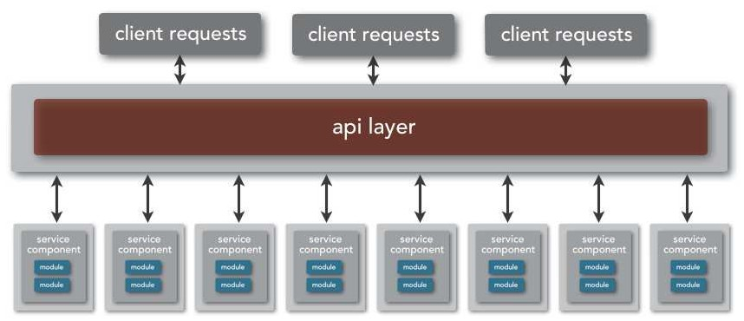
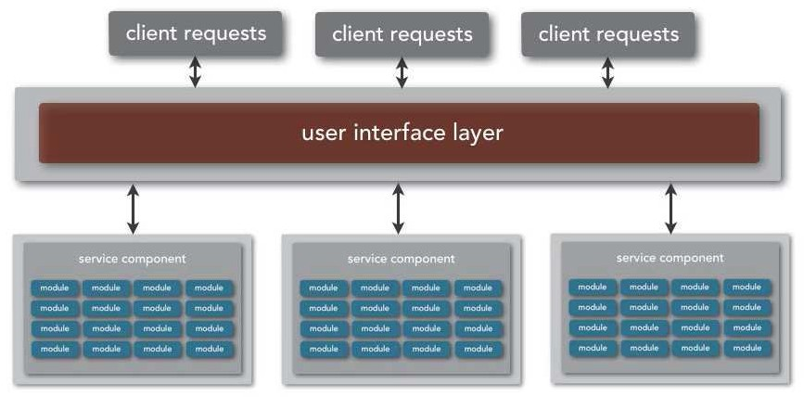


service-based architecture
service granularity
single-purpose micro-service to "portion of the application" macro-service
-

Slide 24

service-based architecture
service granularity
single-purpose micro-service to "portion of the application" macro-service
macro-services resolves orchestration and transactional issues
-

Slide 25
service-based architecture
service granularity
single-purpose micro-service to "portion of the application" macro-service
macro-services resolves orchestration and transactional issues allows for complex business processing within a service context
-

Slide 26
service-based architecture
service granularity
single-purpose micro-service to "portion of the application" macro-service
-

Slide 27


service-based architecture
service granularity
single-purpose micro-service to "portion of the application" macro-service
services become harder to develop and test
-

Slide 28


service-based architecture
service granularity
single-purpose micro-service to "portion of the application" macro-service
services become harder to develop and test deployment pipeline requires more planning
-

Slide 29

service-based architecture
service granularity
single-purpose micro-service to "portion of the application" macro-service
services become harder to develop and test deployment pipeline requires more planning
change control becomes more difficult
-

Slide 30










service-based architecture
database scope
client requests
client requests
client requests
api layer

Slide 31




service-based architecture
database scope
client requests
client requests
client requests
user interface layer

Slide 32
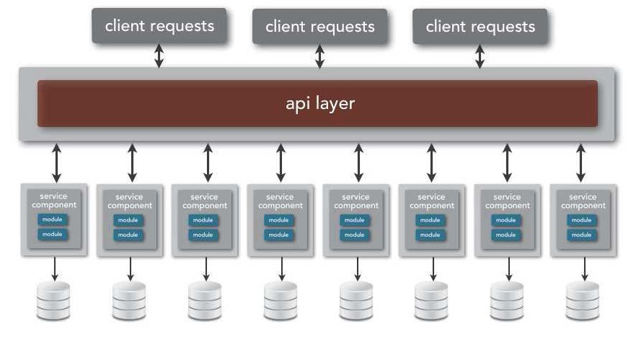
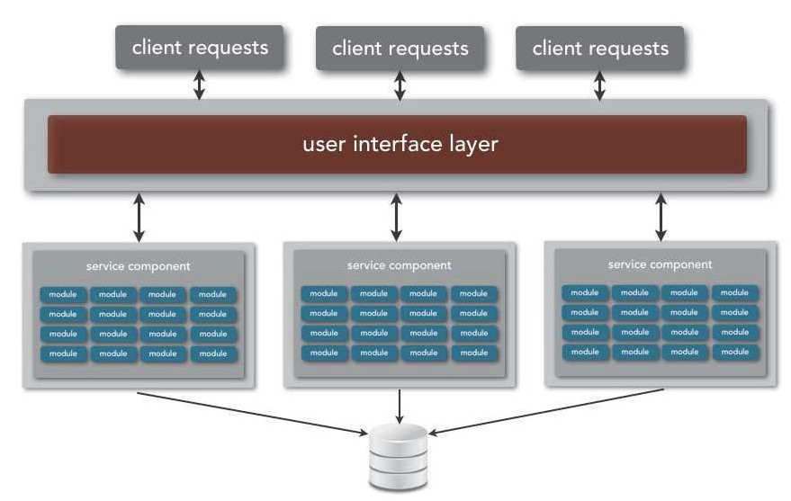


service-based architecture
database scope
single-purpose service-based database to globally shared application database
-

Slide 33


service-based architecture
database scope
single-purpose service-based database to globally shared application database
reduces service orchestration and contract dependencies
-

Slide 34

service-based architecture
database scope
single-purpose service-based database to globally shared application database
reduces service orchestration and contract dependencies improves performance due to fewer remote calls
-

Slide 35

service-based architecture
database scope
single-purpose service-based database to globally shared application database
reduces service orchestration and contract dependencies improves performance due to fewer remote calls refactoring entire database may not be feasible or possible
-

Slide 36
service-based architecture
database scope
single-purpose service-based database to globally shared application database
looser bounded context of services
-

Slide 37

service-based architecture
database scope
single-purpose service-based database to globally shared application database
looser bounded context of services tighter service coupling based on schema
-

Slide 38
service-based architecture
database scope
single-purpose service-based database to globally shared application database
looser bounded context of services tighter service coupling based on schema
schema changes become expensive and difficult
-

Slide 39








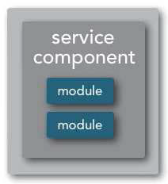
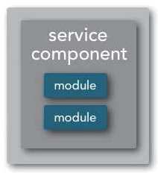
service-based architecture
integration hub
client requests
client requests
client requests
api layer
lightweight message broker

Slide 40









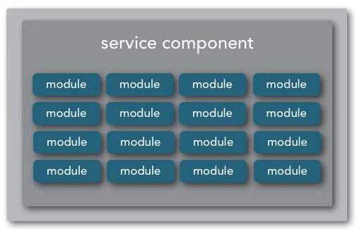
service-based architecture
integration hub
client requests
client requests
client requests
user interface layer
integration hub / middleware

Slide 41
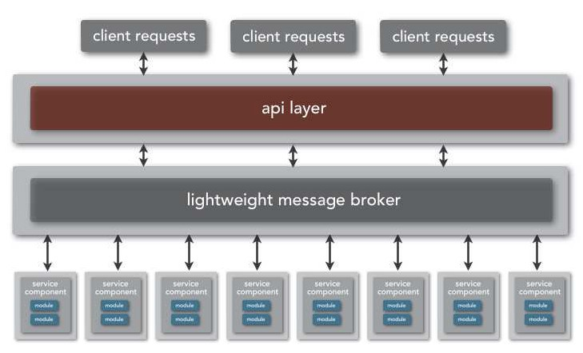
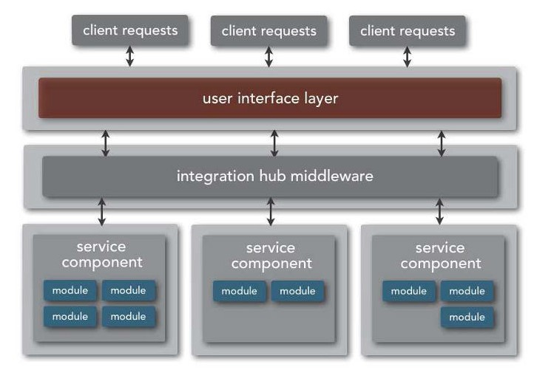



service-based architecture
integration hub
lightweight message broker to heavier integration hub
allows for transformation of contract differences
-

Slide 42

service-based architecture
integration hub
lightweight message broker to heavier integration hub
allows for transformation of contract differences allows for non-transactional orchestration of services
-

Slide 43
service-based architecture
integration hub
lightweight message broker to heavier integration hub
allows for transformation of contract differences allows for non-transactional orchestration of services
allows for protocol-agnostic heterogeneous interoperability
-

Slide 44
service-based architecture
integration hub
lightweight message broker to heavier integration hub
allows for transformation of contract differences allows for non-transactional orchestration of services
allows for protocol-agnostic heterogeneous interoperability allows for common processing logic across all services
-

Slide 45
service-based architecture
integration hub
lightweight message broker to heavier integration hub
decrease in overall performance
-

Slide 46

service-based architecture
integration hub
lightweight message broker to heavier integration hub
decrease in overall performance added complexity and cost
-

Slide 47
service-based architecture
integration hub
lightweight message broker to heavier integration hub
decrease in overall performance added complexity and cost increased need for governance
-

Slide 48
service-based architecture
integration hub
lightweight message broker to heavier integration hub
decrease in overall performance added complexity and cost increased need for governance
deployment pipeline requires much more planning
-

Slide 49

service-based architecture
integration hub
lightweight message broker to heavier integration hub
decrease in overall performance added complexity and cost increased need for governance
deployment pipeline requires much more planning services become harder to develop and test
-

Slide 50














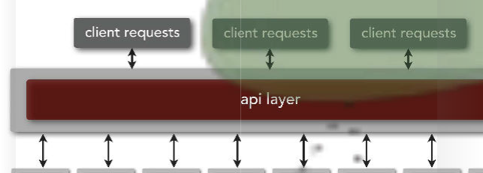

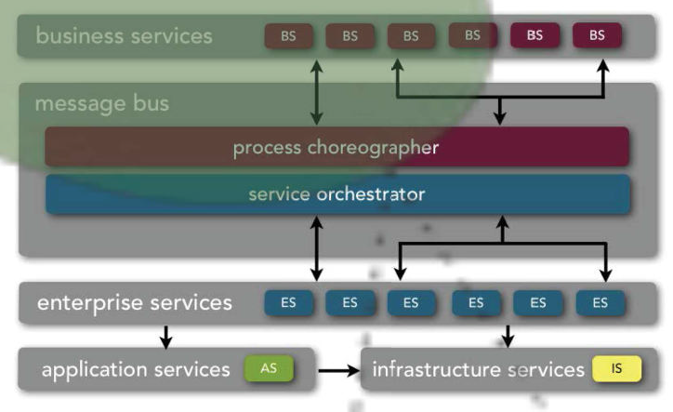


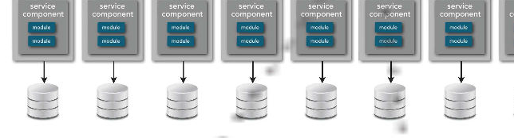
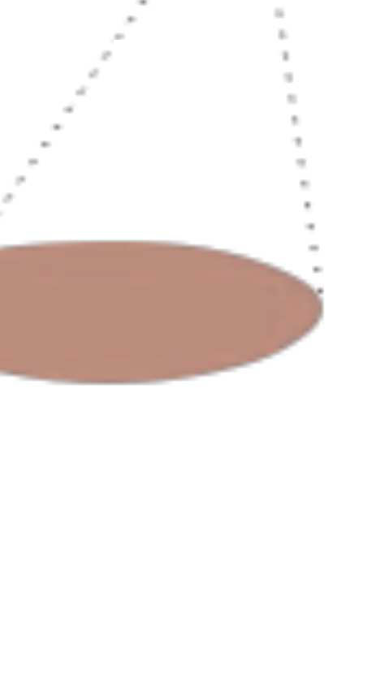















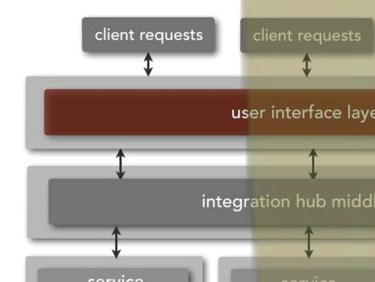
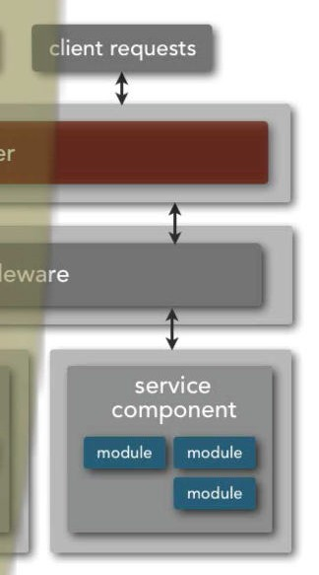

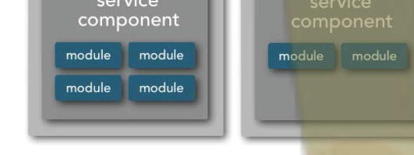










omparing:
c
S
ed
Micro
ervice-orient
Service-based

Slide 51
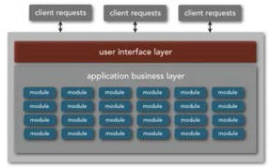
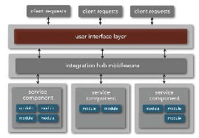
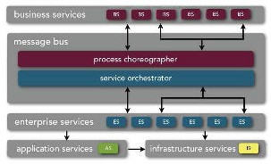
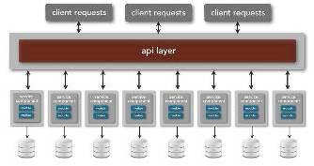
characteristics differences
overall agility
ability to respond quickly to constant change in both business and technology
H
overall agility
M
monolithic architecture
service-based architecture
L
service-oriented architecture
microservices architecture

Slide 52
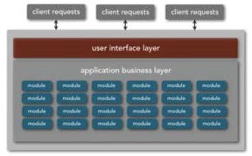
characteristics differences
overall agility
ability to respond quickly to constant change in both business and technology
H
overall agility
M
service-based architecture
L
monolithic architecture
service-oriented architecture
microservices architecture

Slide 53
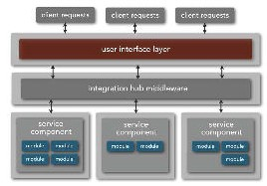
characteristics differences
overall agility
ability to respond quickly to constant change in both business and technology
H
overall agility
M
service-based architecture
L
monolithic architecture
service-oriented architecture
microservices architecture

Slide 54
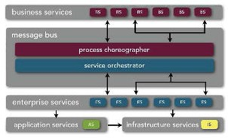
characteristics differences
overall agility
ability to respond quickly to constant change in both business and technology
H
overall agility
M
service-based architecture
L
monolithic architecture
service-oriented architecture
microservices architecture

Slide 55
characteristics differences
overall agility
ability to respond quickly to constant change in both business and technology
H
microservices architecture
overall agility
M
service-based architecture
L
monolithic architecture
service-oriented architecture

Slide 56
characteristics differences
H
t
eploymen f
ase
ease of deployment
promotes an effective and fast deployment pipeline; features are quick and easy to deploy
M
d o
monolithic architecture
service-based architecture
e
L
service-oriented architecture
microservices architecture

Slide 57
characteristics differences
H
t
eploymen f
ase
ease of deployment
promotes an effective and fast deployment pipeline; features are quick and easy to deploy
M
d o
service-based architecture
L
e
monolithic architecture
service-oriented architecture
microservices architecture

Slide 58
characteristics differences
H
t
eploymen f
ase
ease of deployment
promotes an effective and fast deployment pipeline; features are quick and easy to deploy
M
service-based architecture
d o
e
L
monolithic architecture
service-oriented architecture
microservices architecture

Slide 59
characteristics differences
H
t
eploymen f
ase
ease of deployment
promotes an effective and fast deployment pipeline; features are quick and easy to deploy
M
service-based architecture
d o
e
L
monolithic architecture
microservices architecture
service-oriented architecture

Slide 60
characteristics differences
ease of deployment
H
t
eploymen f
ase
promotes an effective and fast deployment pipeline; features are quick and easy to deploy
microservices architecture
d o
M
service-based architecture
e
L
monolithic architecture
service-oriented architecture

Slide 61
characteristics differences
H
tng
s t
f
ase
ease of testing
ease at which features can be tested and verified; confidence level in completeness of testing
M
i e o
monolithic architecture
service-based architecture
e
L
service-oriented architecture
microservices architecture

Slide 62
characteristics differences
H
tng
s t
f
ase
ease of testing
ease at which features can be tested and verified; confidence level in completeness of testing
M
monolithic architecture
service-based architecture
L
i e o
e
service-oriented architecture
microservices architecture

Slide 63
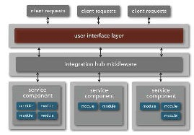
characteristics differences
H
tng
s t
f
ase
ease of testing
ease at which features can be tested and verified; confidence level in completeness of testing
M
i e o
monolithic architecture
service-based architecture
e
L
service-oriented architecture
microservices architecture

Slide 64
characteristics differences
H
tng
s t
f
ase
ease of testing
ease at which features can be tested and verified; confidence level in completeness of testing
M
i e o
monolithic architecture
service-based architecture
e
L
service-oriented architecture
microservices architecture

Slide 65
characteristics differences
ease of testing
H
tng
s t
f
ase
ease at which features can be tested and verified; confidence level in completeness of testing
microservices architecture
i e o
M
monolithic architecture
service-based architecture
e
L
service-oriented architecture

Slide 66
characteristics differences
overall performance
which patterns relatively promote better performing applications?
erformance f
evel
H
p o
M
monolithic architecture
service-based architecture
l
L
service-oriented architecture
microservices architecture

Slide 67
characteristics differences
overall performance
which patterns relatively promote better performing applications?
erformance f
evel
H
p o
monolithic architecture
M
service-based architecture
l
L
service-oriented architecture
microservices architecture

Slide 68
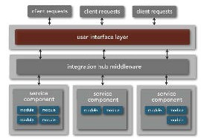
characteristics differences
overall performance
which patterns relatively promote better performing applications?
erformance f
evel
H
p o
monolithic architecture
M
service-based architecture
l
L
service-oriented architecture
microservices architecture

Slide 69
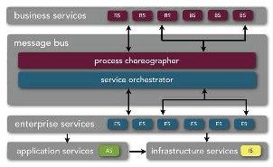
characteristics differences
overall performance
which patterns relatively promote better performing applications?
erformance f
evel
H
p o
monolithic architecture
M
service-based architecture
l
L
service-oriented architecture
microservices architecture

Slide 70
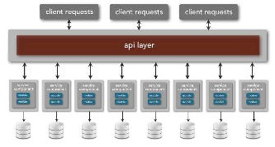
characteristics differences
overall performance
which patterns relatively promote better performing applications?
erformance f
evel
H
p o
monolithic architecture
M
service-based architecture
microservices architecture
l
L
service-oriented architecture

Slide 71
characteristics differences
overall scalability
how well does the architecture pattern lend itself to highly scalable applications?
y t
calabili f
evel
H
s o
M
monolithic architecture
service-based architecture
l
L
service-oriented architecture
microservices architecture

Slide 72
characteristics differences
overall scalability
how well does the architecture pattern lend itself to highly scalable applications?
y t
calabili f
evel
H
s o
M
service-based architecture
L
l
monolithic architecture
service-oriented architecture
microservices architecture

Slide 73
characteristics differences
overall scalability
how well does the architecture pattern lend itself to highly scalable applications?
y t
calabili f
evel
H
s o
M
service-based architecture
l
L
monolithic architecture
service-oriented architecture
microservices architecture

Slide 74
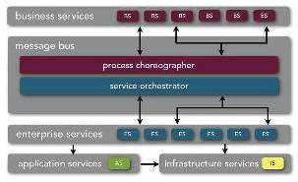
characteristics differences
overall scalability
how well does the architecture pattern lend itself to highly scalable applications?
y t
calabili f
evel
H
s o
M
service-based architecture
service-oriented architecture
l
L
monolithic architecture
microservices architecture

Slide 75
characteristics differences
overall scalability
how well does the architecture pattern lend itself to highly scalable applications?
y t
calabili f
evel
H
microservices architecture
s o
M
service-based architecture
service-oriented architecture
l
L
monolithic architecture

Slide 76
characteristics differences
H
y t
implici f
evel
overall simplicity
level of complexity in applications implemented using the architecture pattern
M
s o
monolithic architecture
service-based architecture
l
L
service-oriented architecture
microservices architecture

Slide 77
characteristics differences
overall simplicity
H
y t
implici f
evel
level of complexity in applications implemented using the architecture pattern
monolithic architecture
s o
M
service-based architecture
l
L
service-oriented architecture
microservices architecture

Slide 78

characteristics differences
overall simplicity
H
y t
implici f
evel
level of complexity in applications implemented using the architecture pattern
monolithic architecture
s o
M
service-based architecture
l
L
service-oriented architecture
microservices architecture

Slide 79

characteristics differences
overall simplicity
H
y t
implici f
evel
level of complexity in applications implemented using the architecture pattern
monolithic architecture
s o
M
service-based architecture
microservices architecture
l
L
service-oriented architecture

Slide 80
characteristics differences
overall simplicity
H
y t
implici f
evel
level of complexity in applications implemented using the architecture pattern
monolithic architecture
s o
M
service-based architecture
microservices architecture
l
L
service-oriented architecture

Slide 81


Which ?!?

Slide 82




Which ?!?
Monolith
default
easy to understand/build
doesn’t scale well in any dimension

Slide 83




Which ?!?
Service-oriented
service taxonomy
high degree of (potential) reuse
highly compatible in integration-heavy environments
operationally complex

Slide 84



Which ?!?
Microservices
incremental change
highly evolvable complex interactions

Slide 85




Which ?!?
service-based
best target for migration good compromise
domain-centric without going µservice

Slide 86

Which ?!?
it depends

Slide 87

Lessons Learned

Slide 88









Partitioning
technical partitioning
domain partitioning
layered architecture
modular monolith

Slide 89




Partitioning
technical partitioning
domain partitioning

Slide 90

Mediator or Broker?

Slide 91
Everything tends towards high coupling!

Slide 92

Everything tends towards high coupling!
Don’t recreate Enterprise Service Buses

Slide 93












































































nealford.com
@neal4d
nealford.com/videos
www.oreilly.com/software-architecture-video-training-series.html
nealford.com/books

